Slide 1
CARDIOVASCULAR DISEASE PREDICTION CPE 695 WS 2 – Applied Machine Learning
JayKumar DineshKumar Patel
Juilee Sameer Thakur
Samyak Pradeep upare
Team 5

Slide 2
CONTENT:
INTRODUCTION
THE MOTIVATION FOR THE PROJECT
DESCRIPTION OF THE DATASET
DATA PREPROCESSING
EXPLORATORY DATA ANALYSIS
MACHINE LEARNING ALGORITHMS
IMPLEMENTATIONS
FUTURE WORK AND CONCLUSION

Slide 3
INTRODUCTION:
Cardiovascular disease has gotten a lot of attention in medical research among the various disorders that are life-threatening.
To anticipate the severity of the patient’s chance of acquiring cardiovascular disease, we gathered data pertaining to every aspect of our field of study and train the data in accordance with the machine learning algorithms.
It is frequently used to categorize whether a patient has cardiovascular disease or is healthy using data mining techniques like logistic regression. The suggested system can extract precise hidden data patterns, relationships, and patterns related to cardiovascular disease from historical cardiovascular disease databases.
It can also provide complex solutions to problems involving cardiovascular disease diagnosis. Making wise clinical decisions could therefore be advantageous for healthcare professionals.

Slide 4
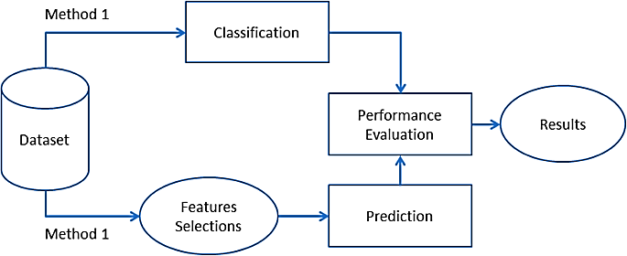
MOTIVATION OF PROJECT:
Machine Learning is used across many spheres around the world. The healthcare industry is no exception. Machine Learning can play an essential role in predicting presence/absence of Heart diseases and more. It is crucial to diagnose the disease at an early stage.
Also, such information, if predicted well in advance, can provide important insights to doctors who can then adapt their diagnosis and treatment per patient basis. Our system is quite reliable for the use of any Cardiovascular disease detections.
The purpose of Cardiovascular Disease prediction is to inform people about their health so they can take steps to protect their health.

Slide 5
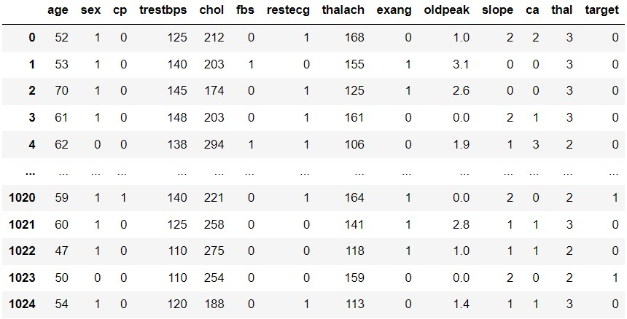
DESCRIPTION OF DATASET.
The study of heart disease analysis focuses primarily on the main causes and factors that have a serious impact on heart health.
We used the dataset from the UCI library.
The dataset contains up to 76 parameters that represent the complete health of the heart. These parameters are determined by traditional heart disease prediction systems using 14 key parameters.

Slide 6
DESCRIPTION OF DATASET.
age: age in years
sex: sex (1 = male; 0 = female)
cp: chest pain type
trestbps: resting blood pressure (in mm Hg on admission to the hospital)
chol: serum cholesterol in mg/dl
fbs: (fasting blood sugar >120 mg/dl) (1 = true; 0 = false)
restecg: resting electro-cardiographic results
thalach: maximum heart rate achieved
exang: exercise induced angina (1 = yes; 0 = no)
oldpeak = ST depression induced by exercise relative to rest
slope: the slope of the peak exercise ST segment
ca: number of major vessels (0-3) (colored by flourosopy)
thal: a blood disorder called thalassemia; 0 = normal; 1 = normal blood flow ; 2 = abnormal blood flow
target: 0 = no disease, 1 = disease

Slide 7
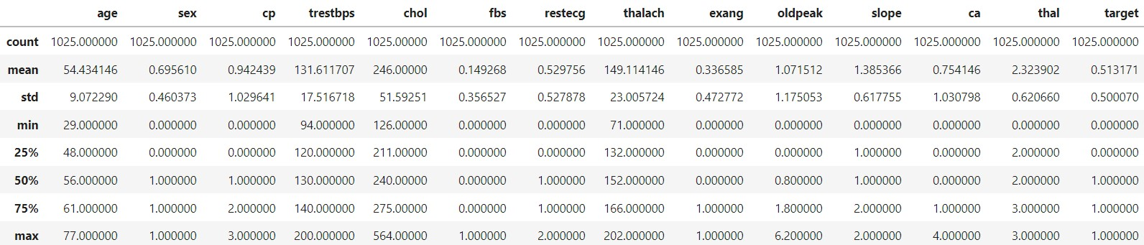
DATA PREPROCESSING
Checked for the missing values
Described the data set to get valuable statistical information
Normalizing the required columns using StandardScaler.

Slide 8
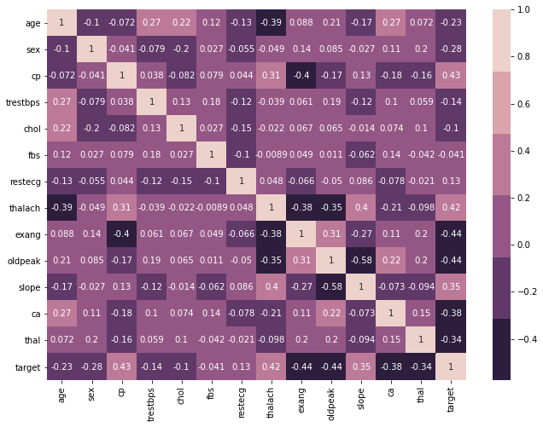
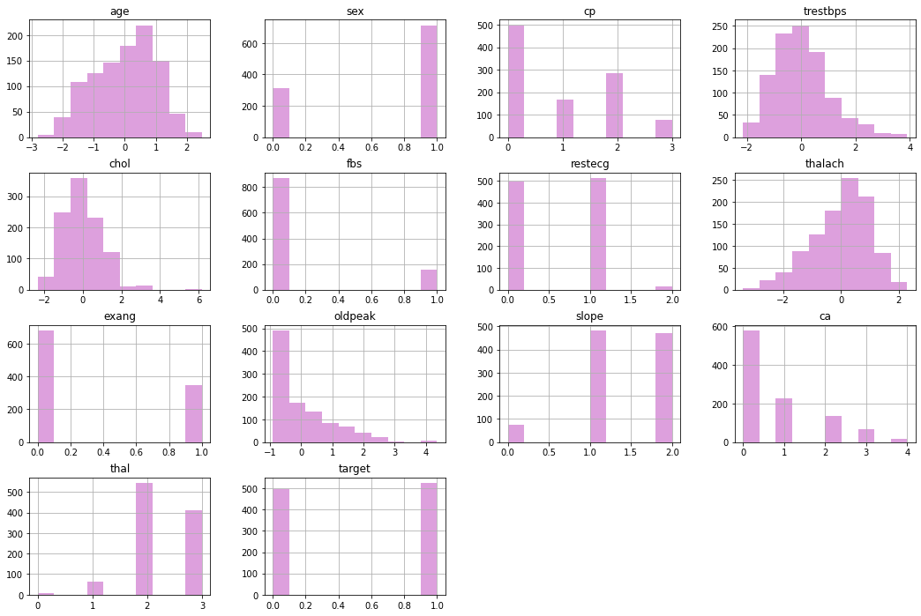
EXPLORATORY DATA ANALYSIS

Slide 9
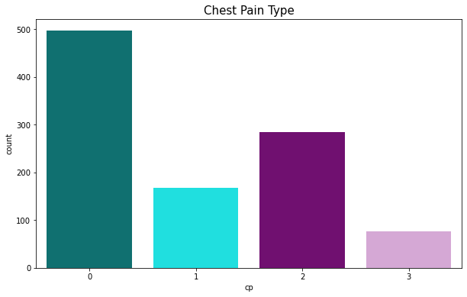
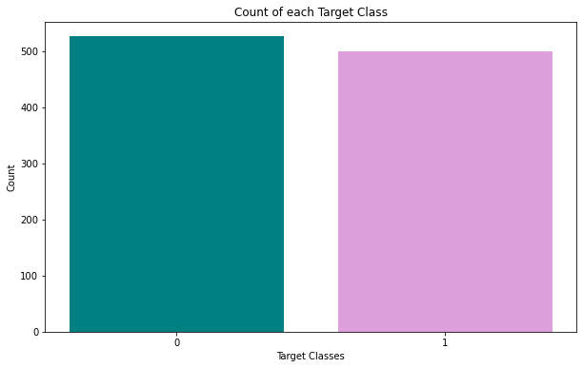
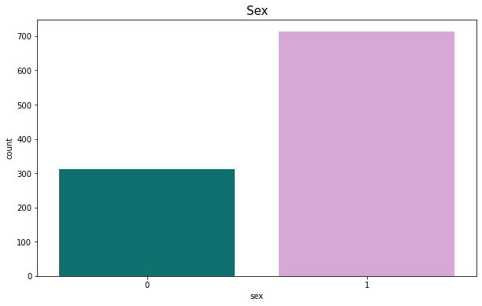
EXPLORATORY DATA ANALYSIS

Slide 10
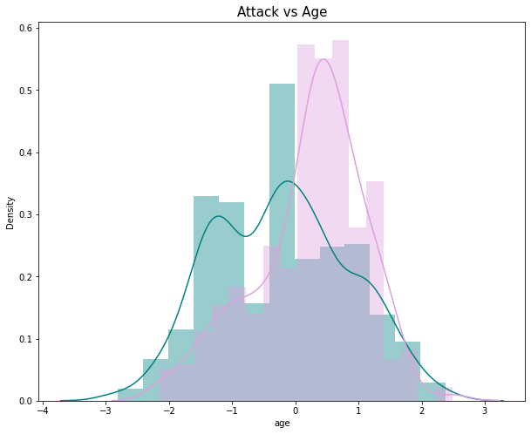
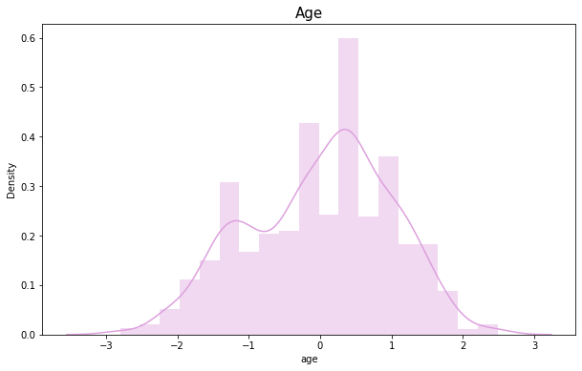
EXPLORATORY DATA ANALYSIS

Slide 11
MACHINE LEARNING ALGORITHMS:
Logistic Regression
Support Vector Machine
K – Nearest Neighbour
Naïve Bayes Theorem
Decision Tree Classifier

Slide 12
LOGISTIC REGRESSION
Logistic regression models are "statistical models which describe the relationship between a qualitative dependent variable and an independent variable”.
Logistic regression models are used to study the effects of predictor variables on categorical outcomes and normally the outcome is binary, such as the presence or absence of disease, in which case the model is called a binary logistic model. When there are multiple predictors (e.g., risk factors and treatments) the model is referred to as a multiple or multivariable logistic regression model and is one of the most frequently used statistical models in medical journals.
Since, our outcome was binary, our project uses a logistic regression algorithm to calculate the accuracy score using sklearn.linear_model library.
According to our Logistic Regression model we get an accuracy of 87.30%

Slide 13
SUPPORT VECTOR MACHINES
Support vector machines (SVMs) are a set of supervised learning methods used for classification, regression, and outliers detection.
SVMs are particularly well suited for the classification of complex but small- or medium-sized datasets.
In our project, using the radial basis function (rbf) kernel, we achieved an accuracy of 91.74% for the Support Vector Machine model.

Slide 14
K- NEAREST NEIGHBOURS
K-Nearest Neighbours is one of the most basic yet essential classification algorithms in Machine Learning. It belongs to the supervised learning domain and finds intense application in pattern recognition, data mining, and intrusion detection.
Picking the right incentive for K To choose the K that is ideal for your information, we run the KNN calculation a few times with various upsides of K and pick the K that diminishes the number of mistakes we experience while keeping up with the calculations capacity to precisely make the forecasts when it’s given the information it hasn’t seen previously.

Slide 15
NAÏVE BAYES ALGORITHM
Bayes theorem provides a way that we can calculate the probability of a piece of data belonging to a given class, given our prior knowledge. Bayes’ Theorem is stated as:
P(class|data) = (P(data|class) * P(class)) / P(data)
Naive Bayes is a classification algorithm for binary (two-class) and multiclass classification problems. It is called Naive Bayes because the calculations of the probabilities for each class are simplified to make their calculations tractable.

Slide 16
DECISION TREE CLASSIFIER
Decision trees work by splitting data into a series of binary decisions.
These decisions allow you to traverse down the tree based on these decisions.
You continue moving through the decisions until you end at a leaf node, which will return the predicted classification.
The algorithm uses a number of different ways to split the dataset into a series of decisions

Slide 17
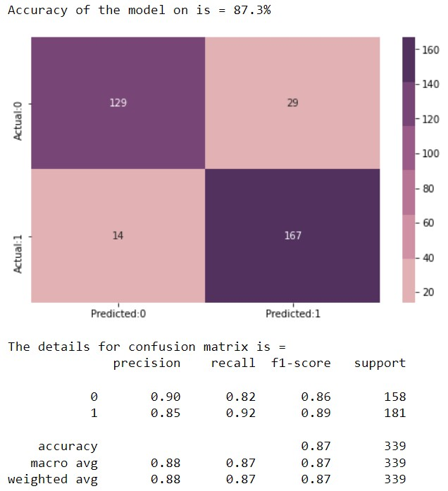
IMPLEMENTATION: LOGISTIC REGRESSION
We build a classifier to detect disease prediction on training data.
After that we trained a logistic regression model.
Once trained, the Logistic Regression classifier can estimate the probability and we get precision of 0 is about 0.9 and for 1 is also 0.85 while recall for 0 is 0.82 and for 1 is 0.92. And accuracy for F1 score is 87%.
Overall accuracy for logistic regression model is 87.30%

Slide 18
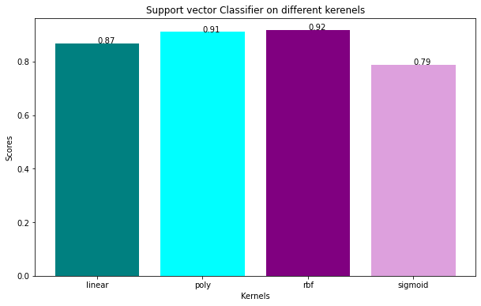
IMPLEMENTATION: SUPPORT VECTOR MACHINES
Initialized Support Vector Machine from the sklearn library and fitting the training data.
Predicted the classes for test set
Calculating the accuracy of the predictions on 4 different Kernels namely linear, poly, rbf, sigmoid
The maximum accuracy obtained was 91.74% with Radial Basis Function (RBF) kernel.

Slide 19
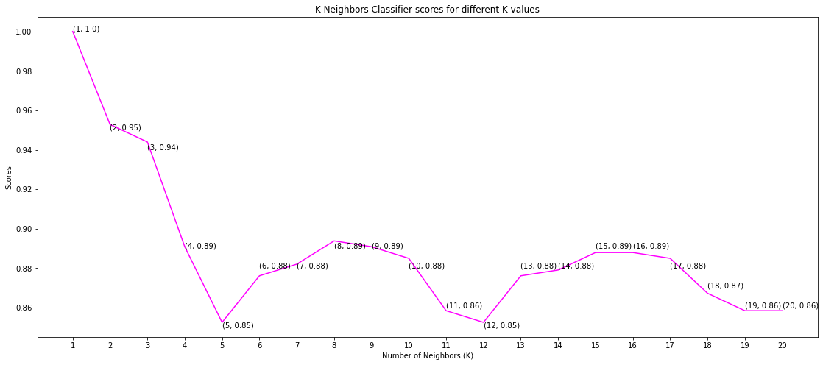
IMPLEMENTATION: KNN
Picking the right incentive for K To choose the K that is ideal for your information, we run the KNN calculation a few times with various upsides of K and pick the K that diminishes the quantity of mistakes we experience while keeping up with the calculations capacity to precisely make the forecasts when it’s given the information it hasn’t seen previously.
We got 88.89% of overall average accuracy by applying KNN algorithm.

Slide 20
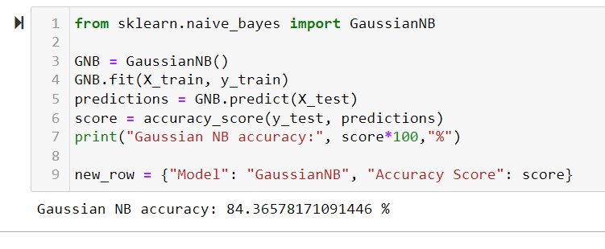
IMPLEMENTATION: NAÏVE BAYES
In this algorithm we firstly, summarized Data By Class.
Then we found out Gaussian probability distribution, which can be calculated as:
f(x) = (1 / sqrt(2 * PI) * sigma) * exp(-((x-mean)^2 / (2 * sigma^2)))
Where sigma is the standard deviation for x, mean is the mean for x and PI is the value of pi.
After that we predicted training data w.r.t gaussian model and achieved the probability of the model by 84.36 %.

Slide 21
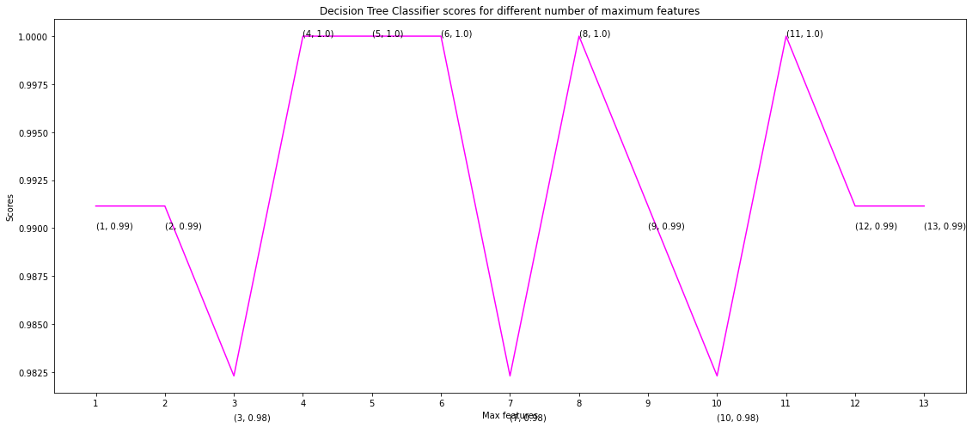
IMPLEMENTATION: DECISION TREE CLASSIFIER
We got 99.25% of overall average accuracy by applying Decision Tree classifier.

Slide 22
IMPLEMENTATION: COMPARISON
Sr. no. | ML Algorithm | Accuracy
1. | Logistic Regression | 87.30%
2. | SVM | 91.74%
3. | KNN | 88.89%
4. | Naïve Bayes | 84.36%
5. | Decision Tree | 99.25%

Slide 23
FUTURE WORK
As we have done heart disease prediction, similar prediction system can be built for various other fatal disease such as cancer, diabetes etc using recent technological advancement like machine learning algorithms, image processing and a variety of other.
Also, new algorithms can be proposed to achieve more accuracy and reliability such as decision tree, Linear Discriminant Analysis as well as Real time patient monitoring system using random forest for disease prediction. Hidden naive bayes can and deep learning algorithms such as LSTM and RNN also be proposed in order to improve accuracy and dependability.
Also big data technologies such as Hadoop Distributed File System can be used to store large amounts of data from all users across the world and to manage the data or reports of those users. Other tools like cloud, mongoDB can also be employed.

Slide 24
CONCLUSION
We can conclude that among the machine learning algorithms such as logistic regression, SVM and KNN, NB and decision tree, we found out that decision tree had the best accuracy considering the performance which is an accuracy of 99.25%. Cardiovascular disease prediction system is proposed to identify the risk of heart disease accurately. Also, the algorithm gives the nearby reliable output based on the input provided by the users. Hence, if the number of people using the system increases, then the awareness about their current heart status will be known and the rate of people dying due to heart diseases will reduce eventually.

Slide 25
REFERENCES
1] Senthilkumar Mohan, Chandrasegar Thirumalati, Gautam Srivastava,”Effective Heart Disease Prediction Using Hybrid Machine Learning Techniques”, IEEE Access.
[2] V.V. Ramalingam, Ayantan Dandapath, M Karthik Raja, ”Heart disease prediction using machine learning techniques: a survey”, International Journal of Engineering Technology, 7 (2.8) (2018) 684-687
[3] K.Srinivas, Dr.G.Raghavendra Rao, Dr. A.Govardhan, ”Analysis of Coronary Heart Disease and Prediction of Heart Attack in Coal Mining Regions Using Data Mining Techniques”, The 5th International Conference on Computer Science Education Hefei, China, August 24–27, 2010.
[4] Devansh Shah, Samir Patel, Santosh Kumar Bharti,”Heart Disease Prediction using Machine Learning Techniques”,SN Computer Science (2020) 1:345, pp1-6, October 2022.

Slide 26
THANK YOU.

